Slide 1
BDA 551 Group Project Forecasting House Prices
Kerim ACAR
Leyla YİGİT
Gökçe EZEROĞLU

Slide 2
OUTLINE
Models kısmı eklenecek
Exploratory Data Analysis
Overall View of Data
Missing Values
Sales Price Distribution
Data Preprocessing
Handling Missing Values
Feature Engineering for date features
Correlation
Handling Uninformative Features
Handling Categorical Features
Labeling for Classification
MODELS GELECEK

Slide 3
Exploratory Data Analysis

Slide 4
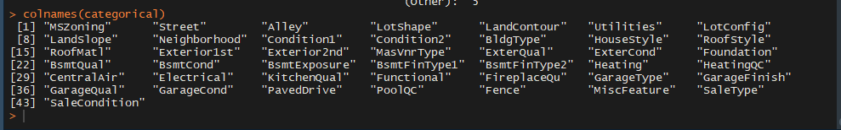
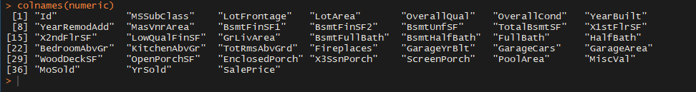
1.1 Overall View of Data
Shape of train data: 999X 81
Shape of test data: 461X 81
Categorical: 43
Numeric: 38
Categorical Features
Numeric Features

Slide 5
1.2 Table of Missing Values
TRAIN FEATURES | Percentage of N/A
PoolQC | 99.7997998
MiscFeature | 95.6956957
Alley | 93.4934935
Fence | 80.5805806
FireplaceQu | 47.7477477
LotFrontage | 17.3173173
GarageType | 5.6056056
GarageYrBlt | 5.6056056
GarageFinish | 5.6056056
GarageQual | 5.6056056
GarageCond | 5.6056056
BsmtExposure | 2.5025025
BsmtFinType2 | 2.5025025
BsmtQual | 2.4024024
BsmtCond | 2.4024024
BsmtFinType1 | 2.4024024
MasVnrType | 0.6006006
MasVnrArea | 0.6006006
Features higher than 47% missing values
Features with low missing percentages

Slide 6
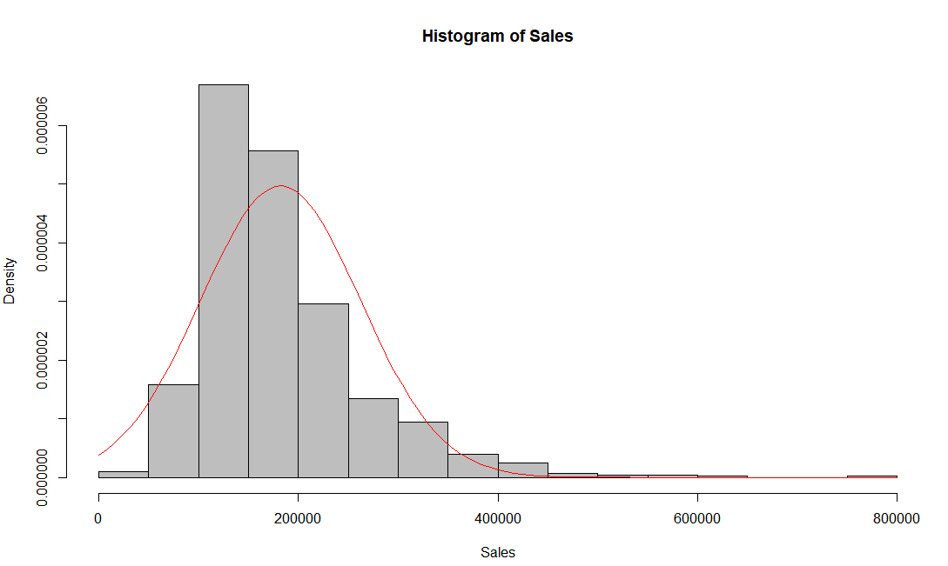
1.3 Distribution of Sales Price
There are 47 outliers which are higher than upper limit.
Outliers are kept
Upper limit=1.5 IQR+ 3rd Quantile
Upper limit=342500
.
Min | 1st Qu. | Median | Mean | 3rd Qu. | Max.
34900 | 130000 | 163990 | 182261 | 215000 | 755000

Slide 7
Data Preprocessing

Slide 8
2.1 Handling Missing Values
Columns with missing values in train dataset and treatment method is listed.
TRAIN FEATURES | Percentage of N/A | Categoric/Numeric | Methodology
PoolQC | 99.7997998 | C | REMOVED
MiscFeature | 95.6956957 | C | REMOVED
Alley | 93.4934935 | C | REMOVED
Fence | 80.5805806 | C | REMOVED
FireplaceQu | 47.7477477 | C | REMOVED
LotFrontage | 17.3173173 | N | Replaced with MODE
GarageType | 5.6056056 | C | Replaced with MODE
GarageYrBlt | 5.6056056 | N | Replaced with MODE
GarageFinish | 5.6056056 | C | Replaced with MODE
GarageQual | 5.6056056 | C | Replaced with MODE
GarageCond | 5.6056056 | C | Replaced with MODE
BsmtExposure | 2.5025025 | C | Replaced with MODE
BsmtFinType2 | 2.5025025 | C | Replaced with MODE
BsmtQual | 2.4024024 | C | Replaced with MODE
BsmtCond | 2.4024024 | C | Replaced with MODE
BsmtFinType1 | 2.4024024 | C | Replaced with MODE
MasVnrType | 0.6006006 | C | Replaced with MODE
MasVnrArea | 0.6006006 | N | Replaced with MODE

Slide 9
2.2 Handling Missing Values
Features with high proportion of missing values are removed.
# Alley = 93.5%
# FireplacesQu = 47.7%
# PoolQC = 99.7%
# MiscFeature = 95.6%
# Fence = 80.5%

Slide 10
2.3 Handling Missing Values
Missing values are replaced with mode.
replacing missing values with mode
GarageType,
GarageYrBlt,
GarageFinish,
GarageQual,
GarageCond,
BsmtExposure,
BsmtFinType2
BsmtQual,
BsmtCond
BsmtFinType1
MasVnrType
MasVnrArea
LotFrontage

Slide 11
2.6 Handling Date Features
Feature engineering is applied for date columns, and summarized in below.
Building_Sold_Age = Year sold- YearBuilt
Garage_Age=Year_Sold-GarageYearBuilt
Remodal_Age=Year_Sold-YearRemodAdd
DATE FEATURE NAME | HANDLING METHOD
YearBuilt | Removed after feature engineering
GarageYearBuilt | Removed after feature engineering
YearSold | Removed after feature engineering
YearRemodAdd | Removed after feature engineering

Slide 12
2.4 Correlation
Correlation of the highligted features with Sales Price is low, these features are dropped.
Var1 | Var2 | value | Removed or Not
X3SsnPorch | SalePrice | 0.009718034 | 1
BsmtFinSF2 | SalePrice | 0.000445434 | 1
BsmtHalfBath | SalePrice | -0.009318442 | 1
Id | SalePrice | -0.010052447 | 1
LowQualFinSF | SalePrice | -0.028544453 | 1
YrSold | SalePrice | -0.031089353 | 1
MiscVal | SalePrice | -0.039497279 | 1
MSSubClass | SalePrice | -0.081028174 | 1
OverallCond | SalePrice | -0.095676699 | 1
yeni modele göre tekrar bakılacak

Slide 13
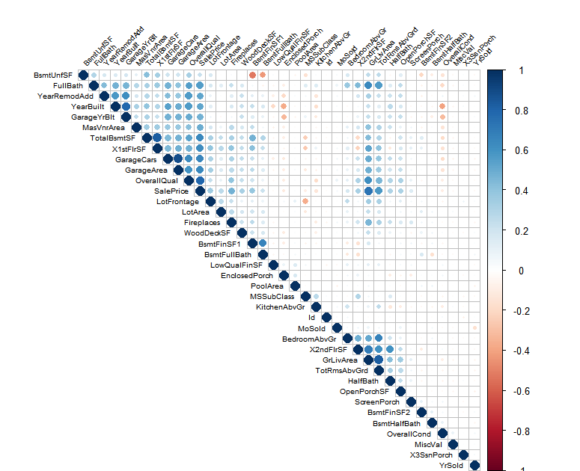
2.5 Correlation
Feature correlation with Sales Price
Kontrol ET, yeni modele göre
Var1 | Var2 | value | Removed or Not
OverallQual | SalePrice | 0.797673472 | 0
GrLivArea | SalePrice | 0.735332725 | 0
GarageCars | SalePrice | 0.65817181 | 0
GarageArea | SalePrice | 0.647943635 | 0
TotalBsmtSF | SalePrice | 0.642095061 | 0
X1stFlrSF | SalePrice | 0.62774209 | 0
TotRmsAbvGrd | SalePrice | 0.570518087 | 0
FullBath | SalePrice | 0.559945193 | 0
YearBuilt | SalePrice | 0.527223837 | 0
YearRemodAdd | SalePrice | 0.526189026 | 0
MasVnrArea | SalePrice | 0.493004147 | 0
GarageYrBlt | SalePrice | 0.476976105 | 0
Fireplaces | SalePrice | 0.473519059 | 0
BsmtFinSF1 | SalePrice | 0.389781429 | 0
LotFrontage | SalePrice | 0.357355305 | 0
X2ndFlrSF | SalePrice | 0.325680165 | 0
WoodDeckSF | SalePrice | 0.324950031 | 0
OpenPorchSF | SalePrice | 0.319513188 | 0
HalfBath | SalePrice | 0.304341318 | 0
LotArea | SalePrice | 0.265622498 | 0
BsmtUnfSF | SalePrice | 0.221275849 | 0
BsmtFullBath | SalePrice | 0.216381641 | 0
BedroomAbvGr | SalePrice | 0.173701103 | 0
ScreenPorch | SalePrice | 0.140835757 | 0
MoSold | SalePrice | 0.039840607 | 0
PoolArea | SalePrice | 0.01250697 | 0
EnclosedPorch | SalePrice | -0.111619772 | 0
KitchenAbvGr | SalePrice | -0.132600657 | 0

Slide 14
2.7 Uninformative Features
Below columns do not have distinct values . They are dropped.
DATE FEATURE NAME | HANDLING METHOD | Same value Count
Street | Removed | 995 pave
Utilities | Removed | 998 AllPub
Condition2 | Removed | 987 norm
RoofMatl | Removed | 980 CompShg
Heating | Removed | 981 GasA

Slide 15
2.8 Handling Categorical Features
One Hot Encoding is applied for the categorical features.
Name Of Colums
MSZoning | LandSlope | RoofStyle | ExterCond | BsmtFinType2 | Functional | SaleType | Street
Neighborhood | RoofMatl | Foundation | Heating | GarageType | SaleCondition | LotShape | Condition1
Exterior1st | BsmtQual | HeatingQC | GarageFinish | LandContour | Condition2 | Exterior2nd | BsmtCond
CentralAir | GarageQual | Utilities | BldgType | MasVnrType | BsmtExposure | Electrical | GarageCond
LotConfig | HouseStyle | ExterQual | BsmtFinType1 | KitchenQual | PavedDrive

Slide 16
2.9 Label Types for Classification
Low (Sales Price)
High(Sales Price)
Sales Price < 150.000 = Low
Sales Price > 150.000 = High
Test and train data sets are balanced after labeling

Slide 17
ModellingGradient Boosting RegressorXgboost Regressor Xgboost Classificationi
Düzelt

Slide 18
3.1 Random Forest
Metric
Accuracy
RMSE score

Slide 19
3.1 Random Forest

Slide 20
3.2 Random Forest
BACK UP

Slide 21
3.3 Random Forest

Slide 22
3.4 Random Forest

